Slide 1


GROUP 7
AIRBNB PRICE PREDICTION BOSTON
12/4/2024
Reshma, Riya, Vibha
01

Slide 2




We want to maximize Airbnb host profits
What factors affect the price of Airbnb listing? What trends and factors impact the listing price?
Analyze which amenities and property types are preferred based on ML models.
Create a Machine Learning Model for predicting the price of a future listing, based on a feature set.
02

Slide 3




Recommendations
We recommend that hosts increase availability and review amenities
Insight 1
Insight 2
Insight 3
Insight 4
Accommodation capacity is one of the highest-rated features
Entire Rental Units are most preferred
Customers rate security and ambience are top amenities
The factors affecting the price are non-linear
03

Slide 4




Methodology
We derived insights using 3 step approach
Feature Importance Analysis
Price Prediction Using ML Models
Textual Data Analysis
04

Slide 5


Methodology
Feature Importance Analysis
We used various data cleaning methods and used SelectKBest method for selecting the 10 most important features out of 37 final features.
05

Slide 6

Methodology
Steps we took in data cleaning
Handling missing values
Removal of duplicate values
Removal of features with no values
One Hot Encoding
Binary encoding
Removing Outliers
Conversion of percentages and currency values to numbers
Remove multi-collinearity in data
06

Slide 7
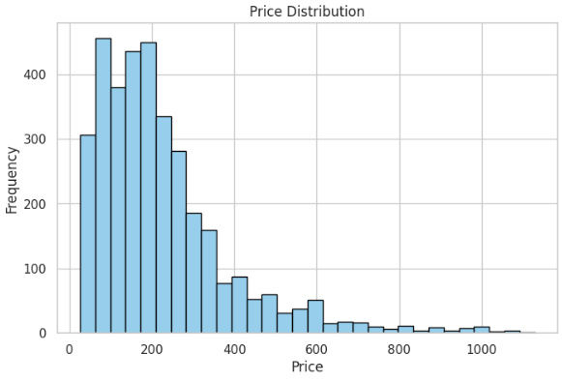
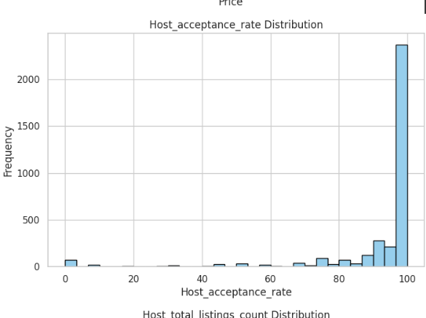
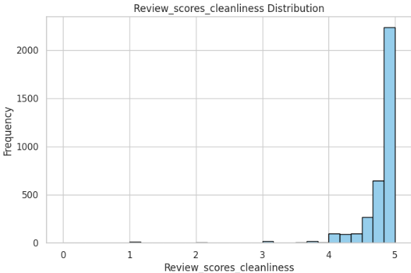
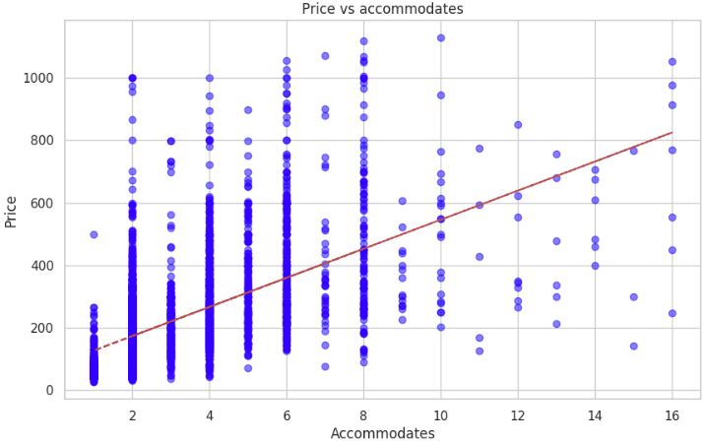
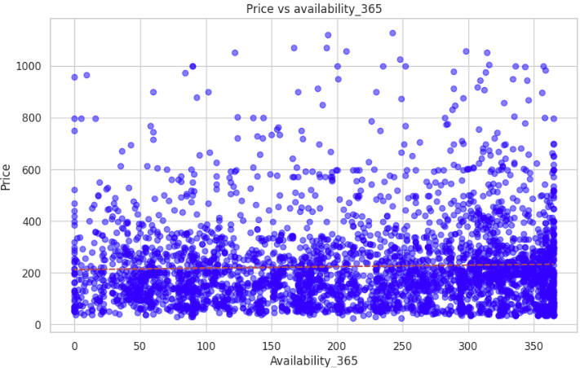
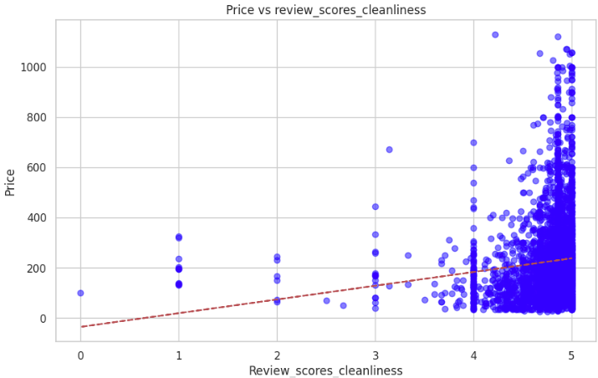
Methodology
We saw some trends between price and features
07

Slide 8
Methodology
We used 4 different ML models for price prediction
Random Forest Regression
XG Boost
Neural Networks
Linear
Regression
08

Slide 9
Methodology
We used 4 different ML models for price prediction
Random Forest Regression
XG Boost
Neural Networks
Linear
Regression
XG Boost had the least error when we hyper-tuned the parameters using GridSearchCV
09

Slide 10
Methodology
Performance comparison using various models
10

Slide 11
Methodology
Based on the R_squared value of Linear Regression, the features are not linearly explaining the model
11

Slide 12

Methodology
Textual Data Analysis
Property Type
Linear Regression and Decision Tree Price prediction based on property type have r_squared value of 3.5%, indicating there is no strong linear relationship between Property type and price.
However, accurate predictions appear for high-frequency listings.
Amenities
Linear Regression and Decision Tree have different top amenities.
Both the models have different error rates and r_squared values
12

Slide 13
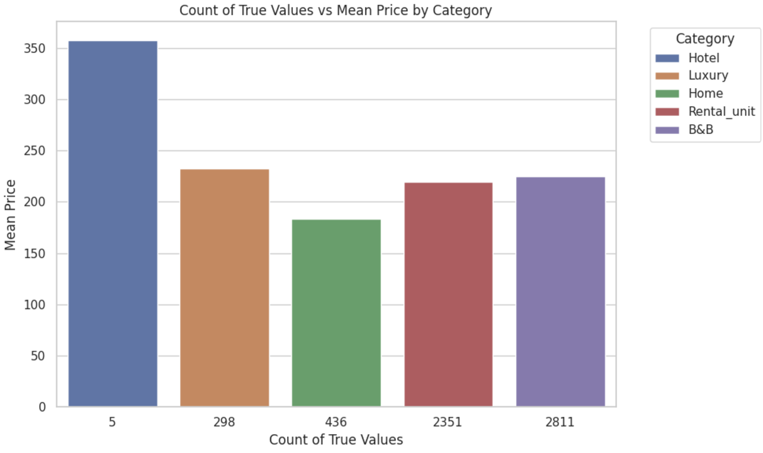
Methodology
Property Type Analysis
The mean price is higher for Hotel-type properties as compared to Luxury or unique-type properties.
Later when we did price prediction using a decision tree for Rental Units, the accuracy was higher than that of luxury units.
13

Slide 14
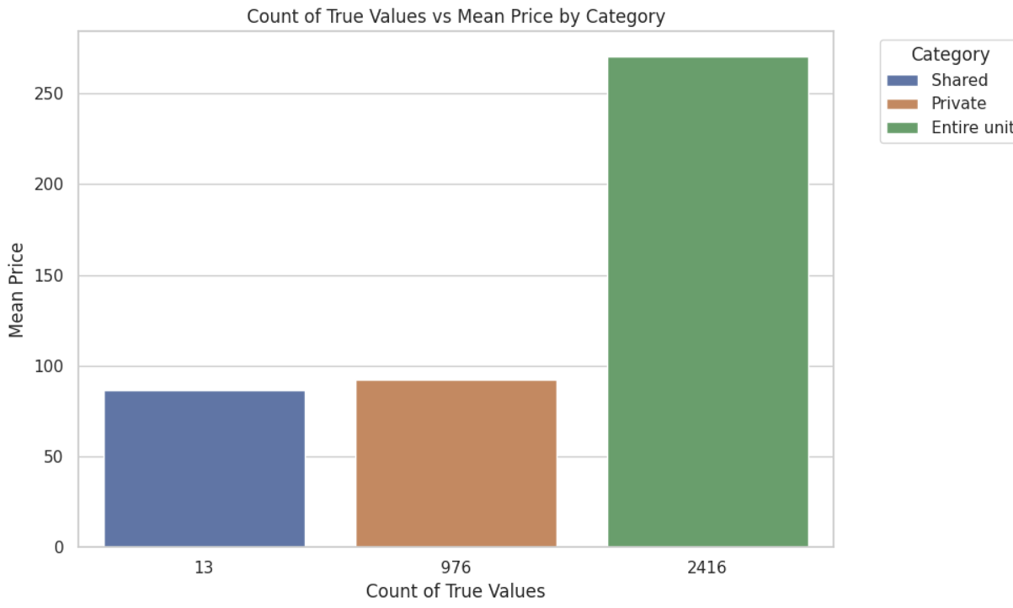
Methodology
Property Type Analysis
The mean price is higher for Entire Units is higher than for Shared units or Private rooms within a unit.
14

Slide 15
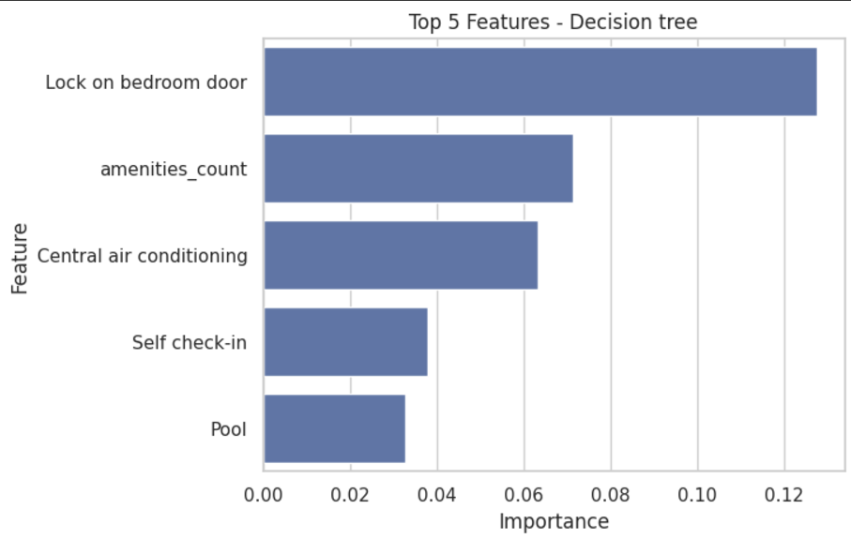


Methodology
Amenities Analysis
The decision tree had a higher performance compared to Linear Regression and the top five amenities based on importance in price prediction are shown in the figure
15

Slide 16


Takeaways
Key takeaways from our analysis
Increasing accommodation capacity can justify a higher listing price
List more entire units over private rooms in a unit or shared units
Increasing availability can fetch more price for hosts
Customers prefer more security and amenities highlighting security features
16

Slide 17




GROUP 7
THANK YOU
Questions?
17

Slide 18
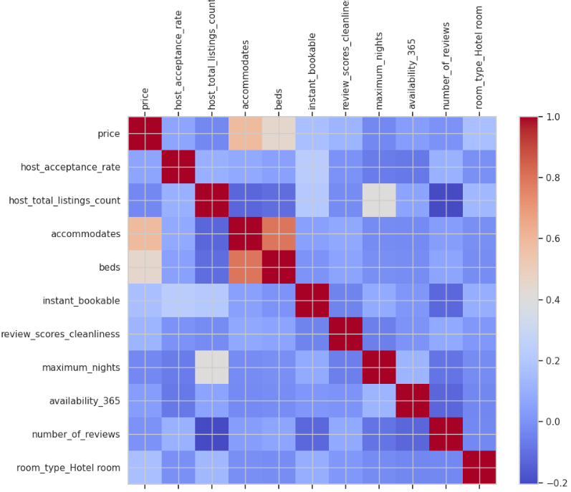
GROUP 7
Appendix
1. Multi-colinearity assessment using the correlation matrix
A1

Slide 19
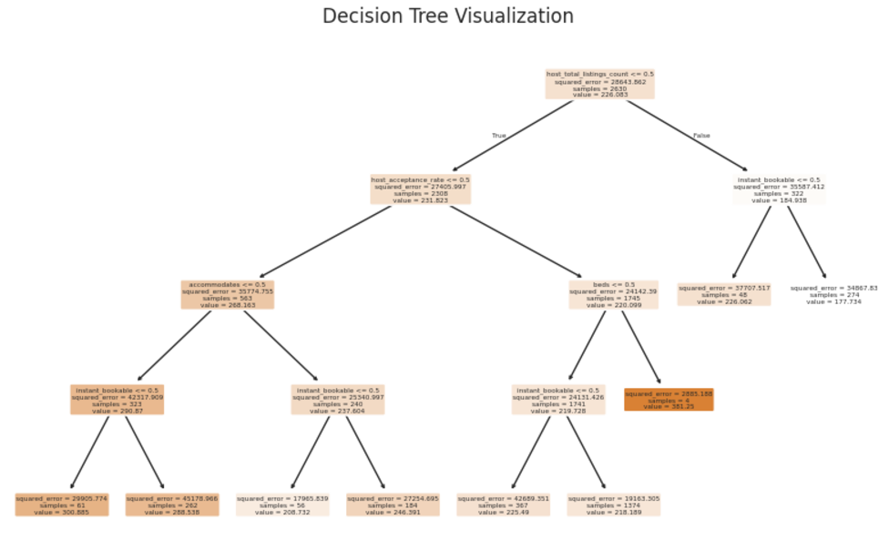
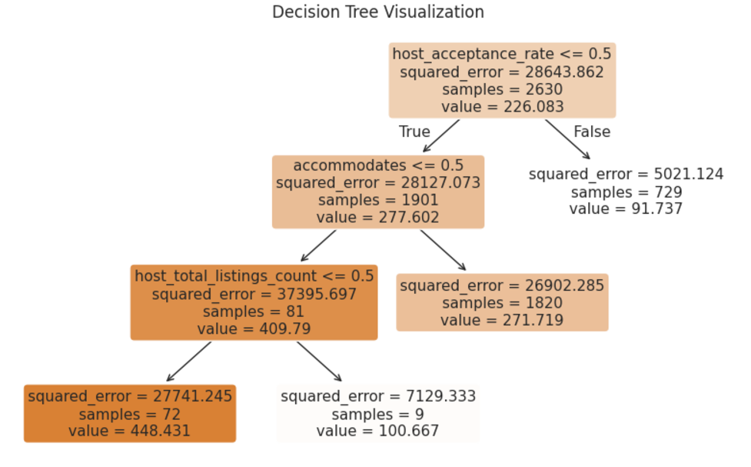
GROUP 7
Appendix
2. Decision Tree Price Prediction based on Property Type
3. Decision Tree Price Prediction based on Room Type
A1

Slide 20
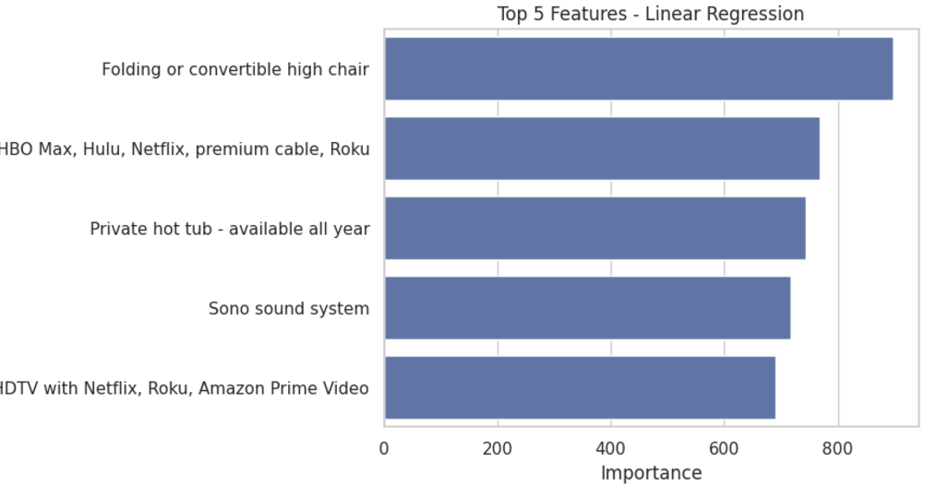
GROUP 7
Appendix
4. Linear Regression Top amenities
A1

Slide 21
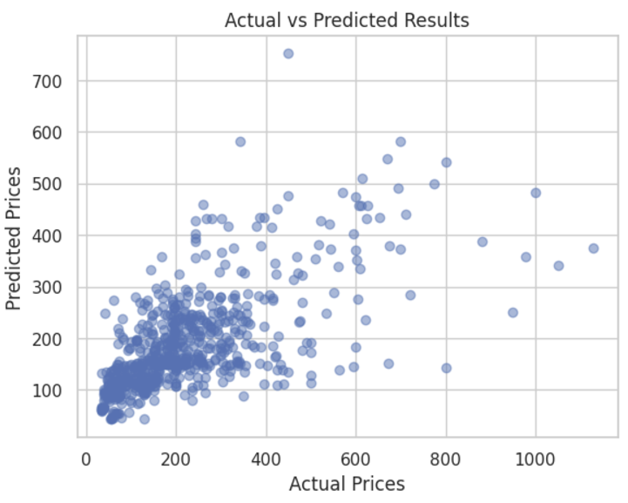
GROUP 7
Appendix
5. Predicted Prices from Neural Network
A1

